Slide 1
Uric Acid Estimation *Hyperuricemia*
Lecturer :Hiba Dawood

Slide 2
What is uric acid
Uric acid is a heterocyclic compound of carbon, nitrogen, oxygen, and hydrogen with the formula C5H4N4O3.
It forms ions and salts known as urates and acid urates.
Uric acid is a product of the metabolic breakdown of purine nucleotides [adenine and guanine], and it is a normal component of urine.

Slide 3
The purines adenine and guanine are constituents of nucleic acid from deoxyribonucleic acid (DNA) and ribonucleic acid (RNA).
The purines used by the body for nucleic acid synthesis may be derived from the breakdown of ingested nucleic acid, mostly from cell-rich meat diet, or they may be synthesized de novo from small molecules.

Slide 4
Pool of Purines
Uric acid is formed in different ways. These are:
1) increased dietary purine intake
2) increased formation (either increased nucleic acid breakdown or increased de novo synthesis of purines)
3) decreased renal excretion
• or a combination of the above.

Slide 6
Metabolism of uric acid
In most other mammals, uric acid further metabolized to the more water-soluble allantoin.
Humans lack uricase and thus their uric acid levels are higher.
It is because of the poor solubility of urate, humans are prone to the clinical effects of hyperuricemia such as gout and other medical condition like renal damage, kidney stones.

Slide 7
Urate Excretion
Urate is filtered through the glomeruli and most is reabsorbed in the proximal tubules. More than 75% that formed in urine is derived from distal tubular secretion, the remaining 25% passes into gut. Urinary excretion is lower in males than in females which may contribute to higher incidence of hyperuricemia in men.

Slide 8
Hyperuricaemia and factors affect Hyperuricaemia
Hyperuricaemia can occur by two main mechanisms: increased production (overproducers) and/or decreased excretion (underexcretors) of uric acid
What is the factors influence uric acid level:
Sex: Serum levels are higher in males than in females
• Obesity: Levels tend to be higher in the obese.
• Social class: The more affluent social classes tend to have a higher serum [urate].
• Diet: a high-protein diet especially meat or seafood. High alcohol consumption because alcohol decrease renal excretion of urate
• Genetic factors : Primary hyperuricemia

Slide 9
Causes of Secondary Hyperuricemai
1) Increased in uric acid production :
A) increased dietary intake of nucleotide.
B) increased the activity of the enzyme amidotransferase [ which catalyzses the first step in purine biosynthesis]
C) increased in tissue turnover like in malignancy, tissue damage: psoriasis or starvation
2) Decrease in renal excretion of uric acid :
A) chronic renal disease
B) drugs ( thiazide diuretics and low dose of salisylate)
C) lead poisoning
D) alcohol intake

Slide 10
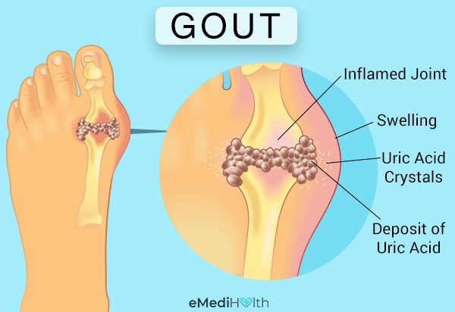
Cosequences of hyperuricemia
1) Urate is poorly soluble in plasma. At a urinary pH below 6, lead to the deposition of urate crystals in renal tissue or the urinary tract to form urate stones.[renal calculi]
2) Crystallization in joints, especially those of the feet (big toe), produces the classic picture of Gout. Urate precipitation at these sites causes an inflammatory response with leucocyte infiltration.

Slide 11
Investigation of Hyperuricemia
A careful drug history is important, such as thiazide diuretics, can evoke hyperuricaemia, as well as a high alcohol intake.
A family history may reveal a primary hereditary form of gout or hyperuricaemia.
Check renal function with plasma urea and creatinine, as renal impairment is a common cause of hyperuricaemia
Consider secondary conditions with high cell turnover, such as tumours, psoriasis

Slide 13
treatment
1) Life style change : weight reduction, decrease intake of red meat
2) Avoid thiazide diuretics
3) Give Uricosuric drugs like Allopurinol the first line treatment [xanthine oxidase inhibitors], Colchicine
4) NSAID like Aspirin, Ibuprofen, Naproxin
5) High fluid intake in patients with renal failure and likelihood of stone formation

Slide 14
Estimation of uric acid by spectrophotometer by [Colorimetric/Uricase method] and calculation **Conc. of standard solution 8 g/dl **measure absorbance at 546 nm

Slide 15
case
A 62-year-old man was treated with chemotherapy by the oncologists for non-hodgkin’s lymphoma. His biochemistry results post-chemotherapy were as follows:
Sodium 137 mmol/L (135–145)
potassium 5.6 mmol/L (3.5–5.0)
urea 11.5 mmol/L (2.5–7.5)
creatinine 138 µmol/L (70–110)
albumin-adjusted calcium 2.19 mmol/L (2.15–2.55)
phosphate 3.17 mmol/L (0.80–1.35)
urate 740 mmol/L (200–430)
What are your comment about this case ?

Slide 16
comment
Where there is rapid growth of dividing tumour cells consequent elevated nucleic acid turnover increased purine metabolism and Hyperuricaemia This is a case of Tumour lysis syndrome, which is the condition can occur after chemotherapy where there is rapid cell destruction with release of purine metabolites and intracellular ions such as potassium and phosphate hyperkalaemia and hyperphosphataemia.

